Slide 1

Green Pace
Security Policy Presentation
Developer: Avery Cross

Slide 2

OVERVIEW: DEFENSE IN DEPTH
Notes:
[Introduce your security policy. Explain why it was needed and how it will be used to support the defense-in-depth best practice.]

Slide 3
THREATS MATRIX
Severity
Low
High
Recursive Loops | Incorrect Variable Data Type
Exception Handling | Buffer Overflow
Low
Likelihood
High
Notes:
[Populate the Threats Matrix table and provide explanations to summarize of all of your security risks.]

Slide 4
10 PRINCIPLES
Validate Input Data
Verify Assigned Data Values
Prevent String Overflow
SQL Prepared Statements
Heed Compiler Warnings
Avoid Implicit Type Conversions
Architect and Design for Security Policies
Use Smart Pointers
Handle Errors with Exceptions
Cap Recursive Functions
Keep It Simple
Avoid Implicit Type Conversions
Use Smart Pointers
Use Assertions As Needed
Default Deny
6. Adhere to the Principle of Least Privilege
7. Sanitize Data Sent to Other Systems
Prevent Overflow with Strings
8. Practice Defense in Depth
Use Larger Data Types
9. Use Effective Quality Assurance Techniques
Handle Errors with Exceptions
Cap Recursive Functions
10. Adopt a Secure Coding Standard
Use Consistent Naming Conventions
Notes:
[List the 10 principles. List the coding standards that apply to each principle. This should demonstrate the alignment between principles and standards.]

Slide 5
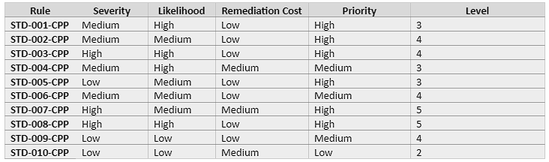
CODING STANDARDS
Avoid Implicit Type Conversion
Check Assigned Data Values
Prevent Overflow with Strings
SQL Prepared Statements
Use Smart Pointers
6. Use Assertions Carefully
7. Handle Errors with Exceptions
8. Use Larger Data Types
9. Cap Recursive Functions
10. Use Consistent Naming Conventions
Risk Assessment
Notes:
[List the 10 coding standards. Explain your own ranking system for vulnerabilities, using specific details from the coding standards in your security policy.]

Slide 6
ENCRYPTION POLICIES
In Flight:
Protects data sent over the network
Encrypted before transmission
Authenticated at endpoint
At Rest:
Data stored on disk or cloud-based storage
Advanced Encryption Standard (AES-256) encryption
In Use:
Harder to protect
PHE or FHE encryption
Prevents complex operations
Notes:
[Explain the policies for encryption in flight, at rest, and in use.]

Slide 7
TRIPLE-A POLICIES
Authentication
First step in Triple-A Policies
SQL database storage
User authenticates with login credentials
Authorization
Determines individual user permissions
Permissions only given as needed
Accounting
Documents user’s usage/actions
Enable compliance for business and security
Notes:
[Explain the policies that support authentication, authorization, and accounting.]

Slide 8
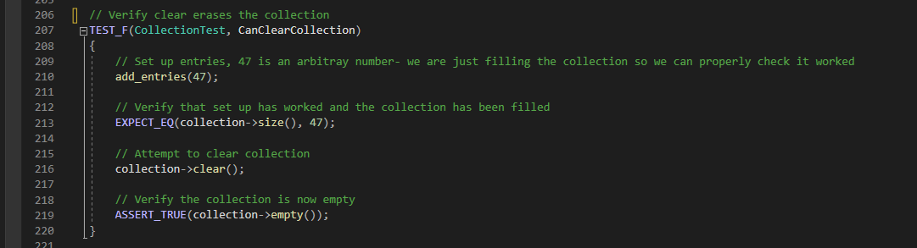
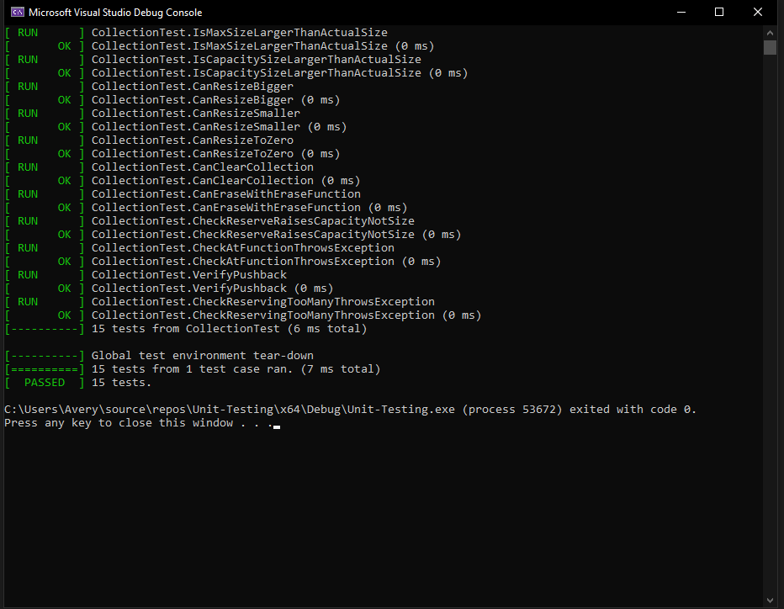
Unit Testing
Unit Testing
Test Clearing Collection

Slide 9
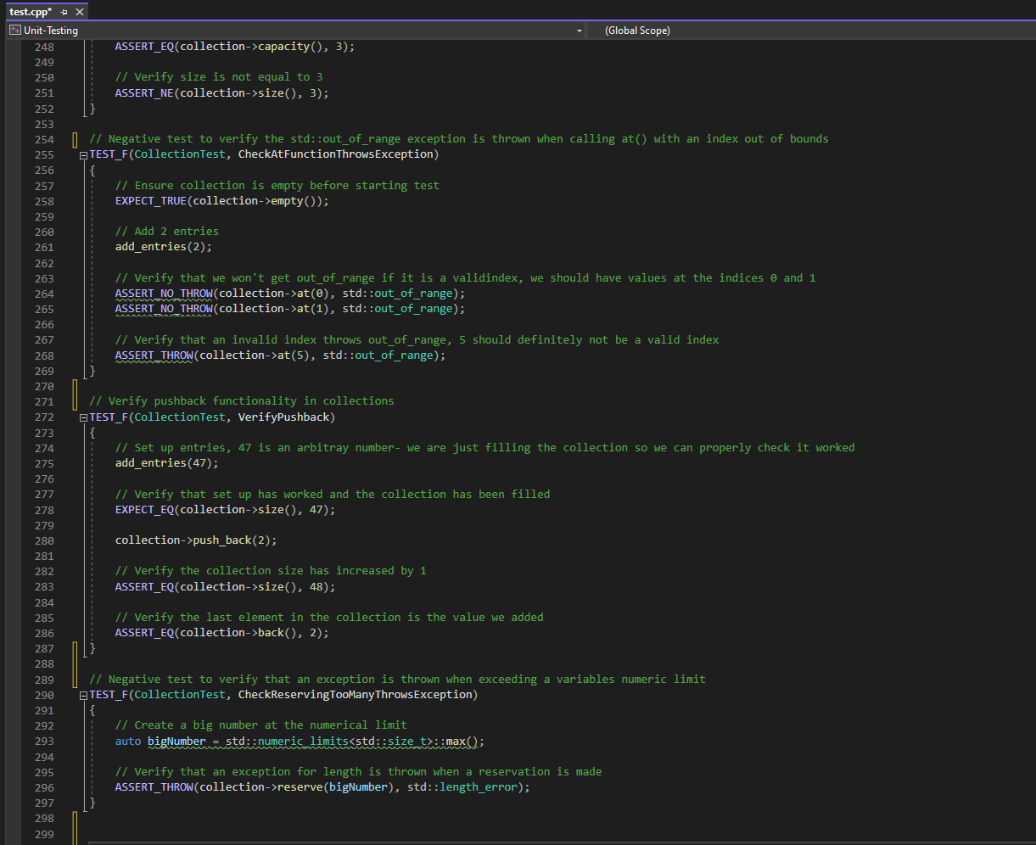
Negative Test for out_of_range exception
Notes:
[Identify the coding vulnerability you chose to test. Include four to six mixed tests for positive and negative results. Include a slide for each test. Use the question for the test as the title. Show the results.]

Slide 10
Test Verifying Collection Pushback

Slide 11
Negative test for exception over numeric limit

Slide 12

AUTOMATION SUMMARY
Notes:
DevSecOps Diagram: Explain where the security tools reside in the flow of automation. State which stages will contain security automation. For instance, when will the compiler be used?

Slide 13
TOOLS
Automatic Compilation Review
Visual Studio
Static Code Analysis
CppCheck
CodeQL
Klocwork

Slide 14
RISKS AND BENEFITS
Risks
Not comprehensive
Less preparation
Benefits
Security from the start
Defense in Depth
Integrate into DevSecOps
Notes:
[Describe the problems, the solutions, and the risks or benefits involved if you act now or wait. Where is the strategy lacking? What are the risks of using this strategy? Which steps should be taken?]

Slide 15
RECOMMENDATIONS
Defense in Depth should include many layers of defense
Keep adding layers of defense
Update with modern standards, as needed
Adopt coding standards & principles
Add new policies as needed
Perform frequent static code analysis

Slide 16
CONCLUSIONS
Compliance with Cert C++, OWASP, etc.
Verify with static code analysis
Important Coding Standards
SQL Prepared Statements
Prevent Overflow with Strings
User Larger Data Types
Use Smart Pointers
Use Consistent Naming Conventions
Handle Errors with Exceptions
Notes:
[Identify standards that should be adopted to prevent future problems.]

Slide 17
REFERENCES
Das, P. (2023, April 11). In-use encryption. Sotero. https://www.soterosoft.com/blog/data-in-use-encryption-data-in-motion-encryption/
TylerMSFT, Mikejo5000, ghogen, mohitp930, GitHubber17, Saisang, colin-home, & GitHubPang. (n.d.). Write unit tests for C/C++ - Visual Studio (windows). Write unit tests for C/C++ - Visual Studio (Windows) | Microsoft Learn. https://learn.microsoft.com/en-us/visualstudio/test/writing-unit-tests-for-c-cpp?view=vs-2022
What Is Defense In Depth?. Fortinet. (n.d.). https://www.fortinet.com/resources/cyberglossary/defense-in-depth
What is DevSecOps?. IBM. (n.d.). https://www.ibm.com/topics/devsecops

